Slide 1
RA 505 Robot Sensing and Vision Lecture 22
Dr. Rishikesh Kulkarni
Department of Electronics and Electrical Engineering
IIT Guwahati

Slide 2
Syllabus
Binary, monochrome and RGB imaging sensors
Velocity sensors,
Accelerometers
Tactile sensors.
Ultrasound rangefinders
Optical rangefinders - LASER scanner, static LED array
Structured lighting, dynamic focusing
Interfacing of vision sensors

Slide 3
DIGITAL CAMERA
Difference between a silver halide photographic camera and an electronic still camera
Conventional silver halide cameras
Electronic still cameras
Analog storage
Digital storage
Mavica (Magnetic video camera)
image signals captured by the semiconductor image sensor
stored on a magnetic floppy disk.
Why did still video system fail?
Cost
Poor picture print quality (VGA quality (640 × 480 pixels))

Slide 4
DIGITAL CAMERA
Fuji digital still camera DS-1P (CCD+Static RAM)
Kodak DCS-1
Casio QV-10 (LCD monitor display)

Slide 5
DIGITAL CAMERA
Typical arrangement of an SLR digital still camera
Typical block diagram of a digital still camera.
Additional optics (IR filter + Optical LPF)

Slide 6
DIGITAL CAMERA
OPTICS
Objective lens, IR filter, optical low pass filer
IMAGING DEVICES
CCD and CMOS sensors
ANALOG CIRCUIT
Sample-and-hold, color separation, AGC (automatic gain control), level clamp, tone adjustment, ADC
DIGITAL CIRCUIT
DSP; tone adjustment; RGB to YCC color conversion; white balance; image compression/decompression; exposure control, auto focus, and automatic white balance
SYSTEM CONTROL
exposure control (AE), auto focus

Slide 7
DIGITAL STILL CAMERA
Imaging optics, imaging elements, and image-processing technology
retrofocus type
Schematic diagram of single lens
Refractive power/ power of lens = inverse of the focal length
telephoto type

Slide 8
DIGITAL STILL CAMERA
brightness of the lens (the image plane brightness) ∝ 1/F²
When the distance to the object is limited, the image
is formed farther away from the lens than is the case for very far-off objects, so the brightness at the image plane (the surface of the imaging element) is lower.
effective F-number

Slide 9
DIGITAL STILL CAMERA
This equation gives us the brightness at the centre of the image, but the brightness at the periphery of the image is generally lower than this.
The cosine fourth law: theta is the angle diverging from the optical axis facing towards the photographed area on the object side (half the field of view).
‘Wide-angle lens’: field of view of 65 degree or more
‘Telephoto lens’: field of view of 25 degree or less
Modulation transfer function (MTF) and resolution: Frequently used as a standard for evaluating the imaging performance of any lens
Higher the frequency (the more detailed the object pattern), the greater the decline in object reproducibility.
Resolution: measure for evaluating the level of detail that can be captured; line-pairs/mm

Slide 10
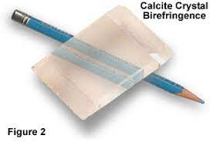

Depth of field and Depth of focus
Optical low-pass filter
DOF = 2u²Fc/f²
u= distant to object
f = focal length
F = F-number
c = circle of least confusion
Depth of focus = 2Fc
Circle of least confusion : 2 to 2.5 units of pixel pitch
Thin, birefringent plates made from liquid crystal or lithium niobate
Diffractive optical elements or special aspherical surfaces
different refractive indexes depending on the direction in which light is polarized
Birefringent material is a single material with two refractive indexes.
used to mitigate the moiré effect caused by the interaction of patterns in the object and the pattern on the imaging element caused by the arrangement of imaging element pixels at a fixed pitch

Slide 11
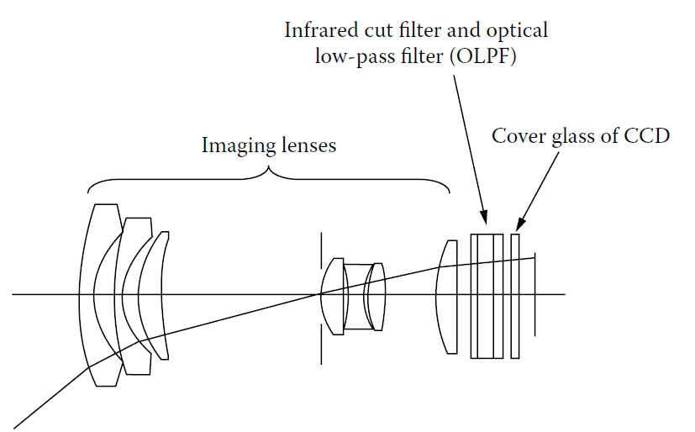
Aberration
Spherical aberration
Comatic
Astigmatism
Curvature of field
Distortion
Axial or longitudinal chromatic aberration
Imaging Optics
Imaging lenses, an infrared cut filter, and an optical low-pass filter (OLPF)
Imaging lenses: zoom lenses, combination of multiple lens
Infrared cut filters: cut out unwanted infrared light; to avoid highly sensitive of imaging element to unwanted infrared light

Slide 12

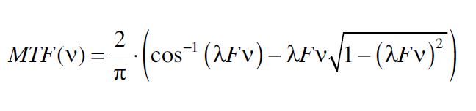
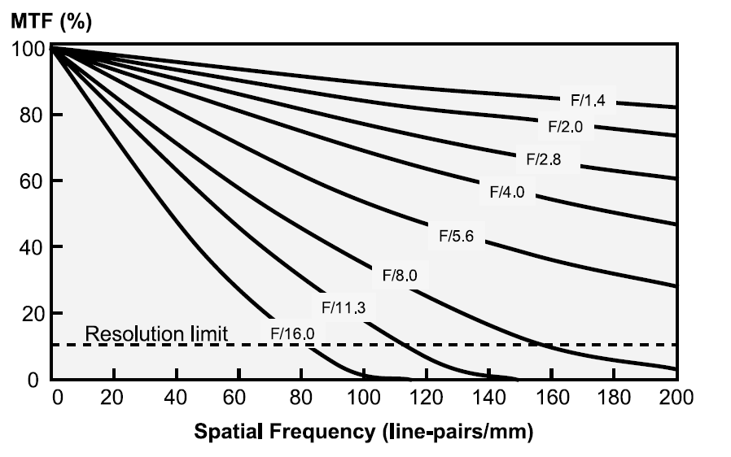
Effect of diffraction
Pixel pitch at the scale of wavelength
Airy disc
helium d-line (587.56 nm)

